Slide 1

Municipal Annexations and the Changing Color Line After Shelby v. Holder
Iris Zhang, Stanford University
August 8th, 2022
Photo: Edward Kimmel/Wikimedia Commons

Slide 2
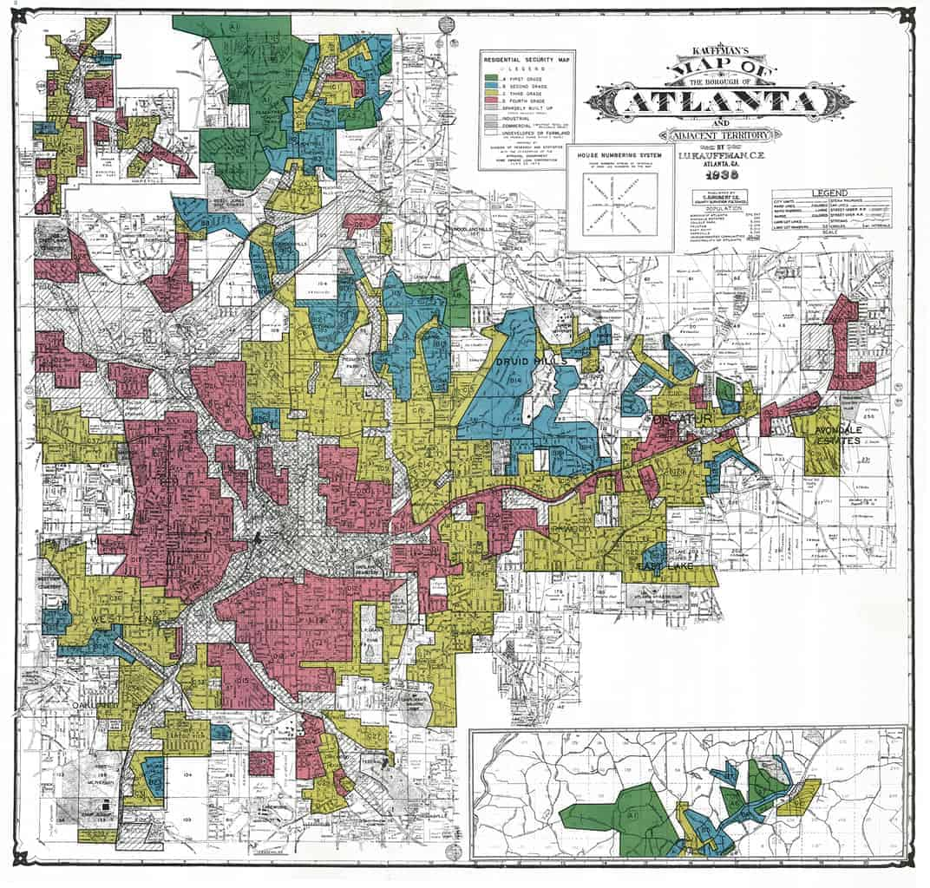
Motivation 1: why places (cities) matter for racial inequality
Many policies contribute to within-place racial segregation (Faber 2020; Rothstein 2017; Charles 2003; Massey and Denton 1993)
Between-place segregation is also growing (Lichter, Parisi, and Taquino 2015; Lichter, Parisi, and Taquino 2012)
Mapping Inequality Project, University of Richmond

Slide 3

Motivation 1: why places matter for racial inequality
Cities have a wide range of tools to shape the racial composition of their city (Trounstine 2020, Lichter 2012)
Zoning, land-use regulations (LaBriola 2022; Lens 2022; Rothwell and Massey 2009; Shlay and Rossi 1981)
Getty images

Slide 4
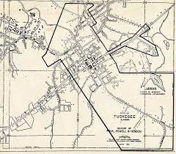
Motivation 1: why places matter for racial inequality
City boundaries themselves can be leveraged as such a form of racial boundary maintenance (Lichter and Brown 2011):
“Municipal underbounding” (Durst 2018; Durst 2019; Lichter et al. 2007)
Map: Encyclopedia of Alabama

Slide 5
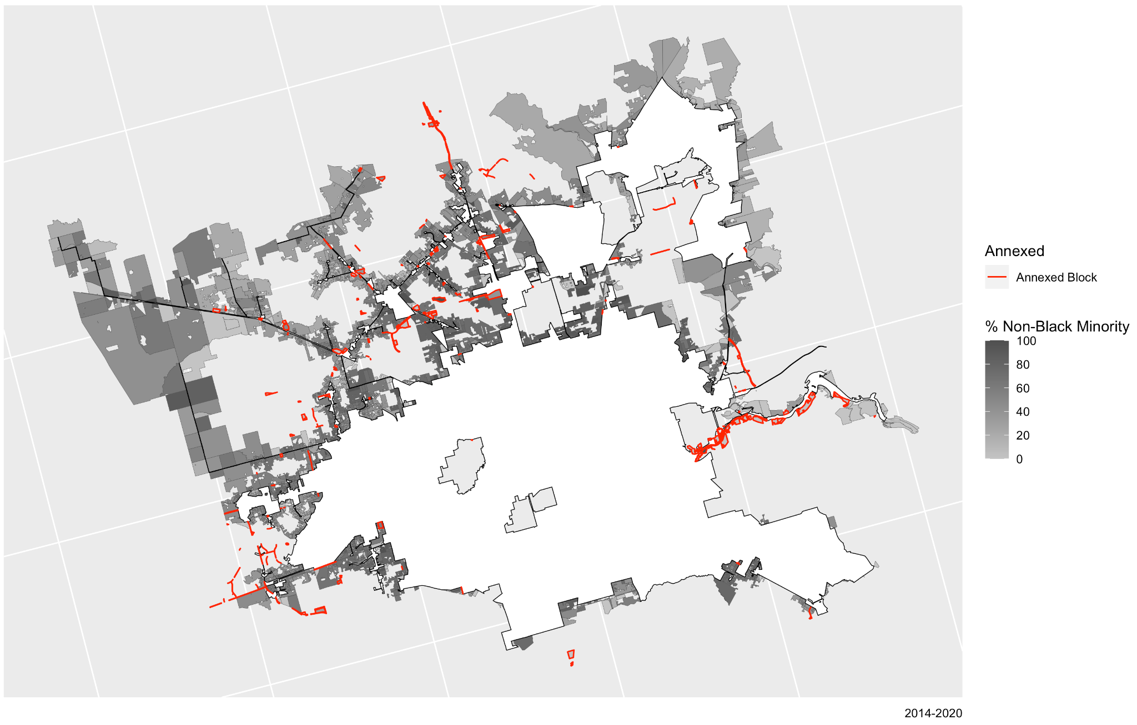
Map: author

Slide 6
Motivation 1: why places matter for racial inequality
Underbounding = cities stay white or become more white?
→ What are the consequences of how municipalities annex?
Minority population dilution that is subject to federal “pre-clearance” by Sections 4 and 5 of the 1965 Voting Rights Act (“VRA”) (Richmond v. Virginia 1970; Gomillion v. Lightfoot 1960; Berri 1989; Motomura 1982; USDOJ).

Slide 7
Motivation 2: the role of regulations in limiting racial discrimination
June 25th, 2013: Shelby v. Holder removed this preclearance requirement
Removing laws that regulate discrimination enables racial discrimination (Reardon et al. 2012)
can become ingrained norms (Hirsh 2009)
can also be ineffective (Cox and Goodman 2018; Hiskey et al. 2018; Ryo 2019, 2021; Wong 2018)

Slide 8
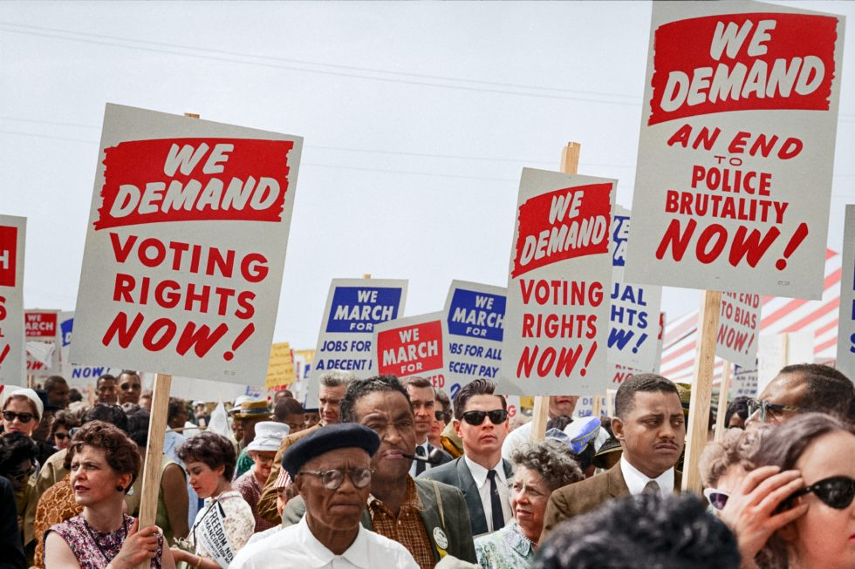
Research Questions
Likelihood to conduct annexations
Demographic consequences of annexations
Do these vary for Black versus other minority racial groups?
Photo: Lawyers’ Committee for Civil Rights

Slide 9
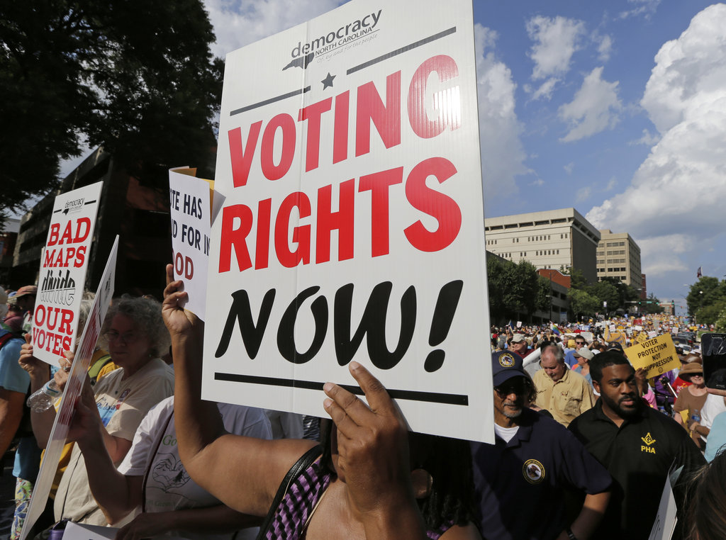
Data
Block- and place-level demographic data with interpolation, including LODES
Block- and place-level shapefiles
Analytical sample: 15,000 cities in the contiguous US (no NE states, 2000-2020)
Image: National Urban League

Slide 10
Data: identifying annexations
Official records (BAS) are extremely incomplete and not enough geographic detail
Boundaries change over time

Slide 11
Validation with BAS

Slide 12
Models: difference-in-differences set-up
Model 1 (annexation): post-Shelby*Section 5 coverage
Model 2 (racial composition at end of period): annexation*post-Shelby*Section 5 coverage
2000-2007 used to test additional pre-trends

Slide 13
Results
Cities are significantly less likely to annex after Shelby

Slide 14
No effect of Shelby on racial composition share after annexations
Annexation is associated with a lower percent white population in Section 5 cities after Shelby

Slide 15
Because it didn’t work before?
- Unlikely just an anticipation effect of 2007-2013

Slide 16

Conclusions
Federal oversight is still important, even if removing it didn’t have immediately devastating consequences
- Limitation: lack of political variables
Black exceptionalism
Limitation: need better qualitative data
Photo: Evelyn Hockstein / The Washington Post / Getty

Slide 17

Thank you!
ihzhang@stanford.edu
ccrl.stanford.edu
Complete replication code in progress--
(open-access R code + every dataset/shapefile): github.com/ihzhang/Municipal-Boundary-Changes.

Slide 18
Extra

Slide 19
Data
1. 2000, 2010, and 2020 Census block-level data (2010 boundaries)
2. Linearly interpolated for 2007 and 2014
3. LODES WAC and RAC data (2010 boundaries)
4. 2000, 2010 Census, and 2020 Census; 2012-2016 and 2015-2019 ACS place-level data
5. 2000, 2007, and 2014 block shapefiles
6. 2000, 2007, 2013, 2014, and 2020 place shapefiles
*2010 boundaries using NHGIS crosswalk

Slide 20
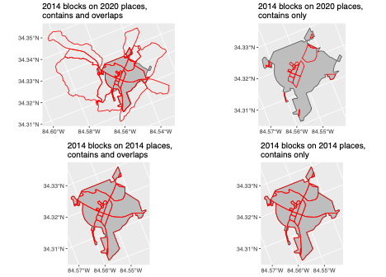
Notes:
Process of identifying annexations first involves looking at which blocks are part of the place boundaries at the beginning and end of the period. Blocks that existed at the beginning of the period (and at the end), that were in place boundaries at the end of the period but not in the first, are considered annexed.
If it’s a census year, the block-level file from NHGIS will actually include a place identifier, but not for intercensal years.

Slide 21
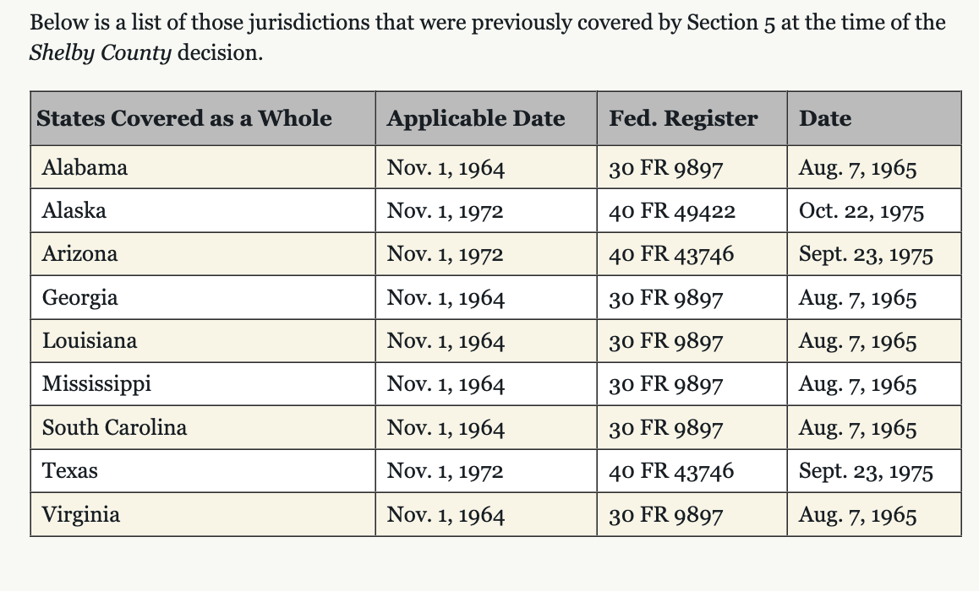
Notes:
In part: California, Florida, NY, NC, SD, MI

Slide 23
Next
Compare available annexable land over time
Delve into null finding
Need to add in HI and AS

